Slide 1



UNIVERSITY INSTITUTE OF ENGINEERING
COMPUTER SCIENCE ENGINEERING
Bachelor of Engineering
Cloud Computing(CST-411)
Prepared By: Ms. Himanshu(E11818)
Topic: Service Benefits, Limitations
and Risks of Cloud Computing
DISCOVER . LEARN . EMPOWER

Slide 2
Learning Objectives & Outcomes
Objective:
To understand the Benefits and Limitations of Cloud Computing
Outcome:
Student will understand
Benefits of Cloud Computing
Limitations of Cloud Computing
Risks of Cloud Computing

Slide 3
Overview
Benefits of Cloud Computing
Limitations of Cloud Computing
Risks of Cloud Computing

Slide 4

Benefits

Slide 5
Benefits of Cloud Computing
Cloud Computing is an emerging technology that almost every company is being switched to from its on-premise technologies.
Benefits are:
Cost efficiency: The biggest reason behind companies shifting to Cloud Computing is that it takes considerably lesser cost than any on-premise technology. Now, companies need not store data in disks anymore as the cloud offers enormous storage space, saving money and resources.
High speed: Cloud Computing lets us deploy the service quickly in fewer clicks. This quick deployment lets us get the resources required for our system within minutes.

Slide 6
Excellent accessibility: Storing information in the cloud allows us to access it anywhere and anytime regardless of the machine making it a highly accessible and flexible technology of the present times.
Back-up and restore data: Once data is stored in the cloud, it is easier to get its back-up and recovery, which is quite a time-consuming process in on-premise technology.
Manageability: Cloud Computing eliminates the need for IT infrastructure updates and maintenance since the service provider ensures timely, guaranteed, and seamless delivery of our services and also takes care of all the maintenance and management of our IT services according to the service-level agreement (SLA).

Slide 7
Sporadic batch processing: Cloud Computing lets us add or subtract resources and services according to our needs. So, if the workload is not 24/7, we need not worry about the resources and services getting wasted and we won’t end up stuck with unused services.
Strategic edge: Cloud Computing provides a company with a competitive edge over its competitors when it comes to accessing the latest and mission-critical applications that it needs without having to invest its time and money on their installations.

Slide 8
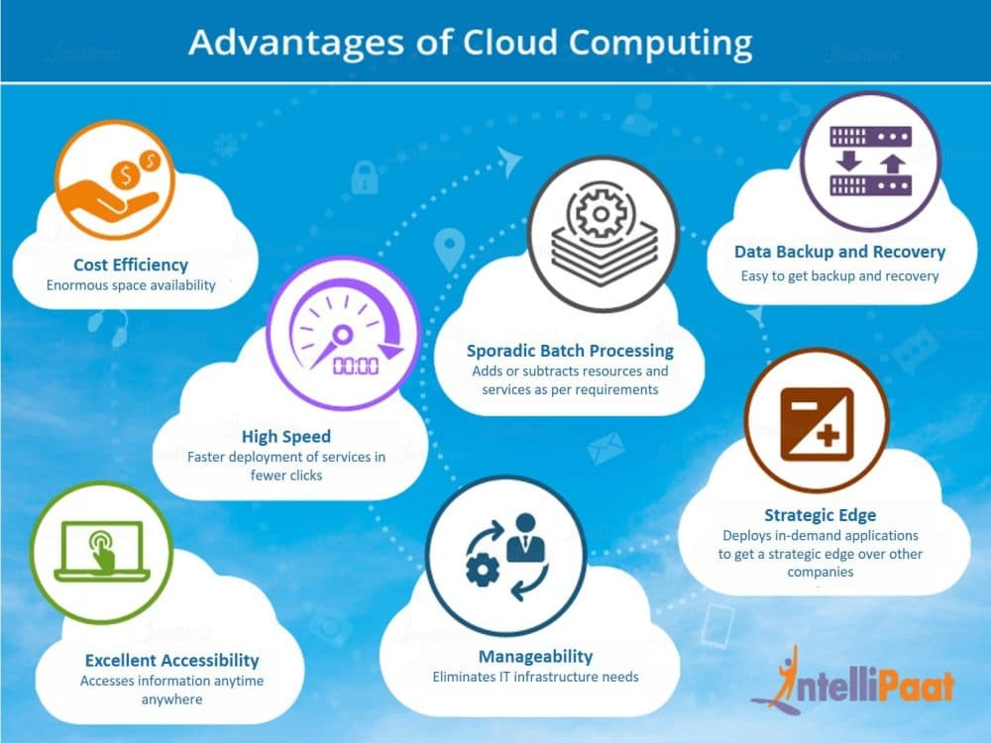

Slide 9
Limitations

Slide 10
Limitations of Cloud Computing
Every technology has both positive and negative aspects that are highly important to be discussed before implementing it.
Limitations are:
Vulnerability to attacks: Storing data in the cloud may pose serious challenges of information theft since in the cloud every data of a company is online. Security breach is something that even the best organizations have suffered from and it’s a potential risk in the cloud as well.
Network connectivity dependency: Cloud Computing is entirely dependent on the Internet. This direct tie-up with the Internet means that a company needs to have reliable and consistent Internet service as well as a fast connection and bandwidth to reap the benefits of Cloud Computing.

Slide 11
Downtime: Downtime is considered as one of the biggest potential downsides of using Cloud Computing. The cloud providers may sometimes face technical outages that can happen due to various reasons, such as loss of power, low Internet connectivity, data centers going out of service for maintenance, etc. This can lead to a temporary downtime in the cloud service.
Vendor lock-in: When in need to migrate from one cloud platform to another, a company might face some serious challenges because of the differences between vendor platforms. Hosting and running the applications of the current cloud platform on some other platform may cause support issues, configuration complexities, and additional expenses.
Limited control: Cloud customers may face limited control over their deployments. Cloud services run on remote servers that are completely owned and managed by service providers, which makes it hard for the companies to have the level of control that they would want over their back-end infrastructure.

Slide 12
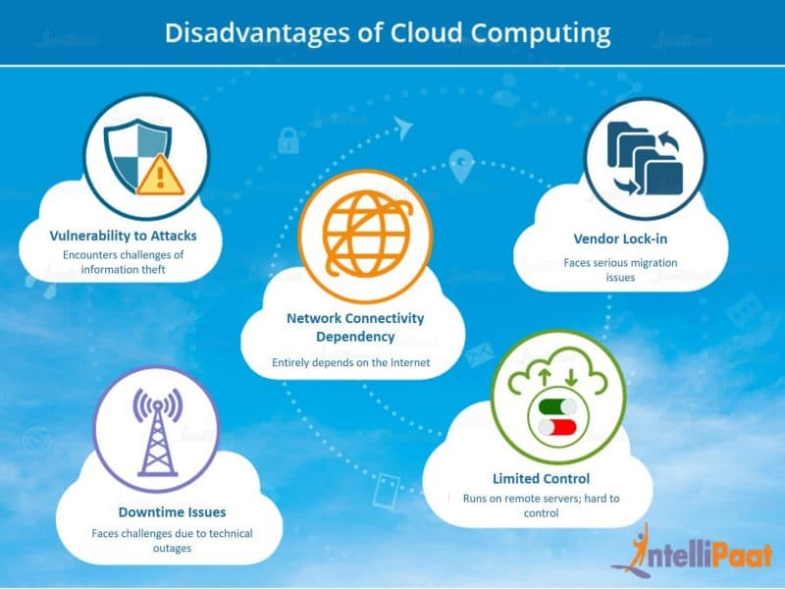

Slide 13

Risks related to Cloud Computing

Slide 14
Risks of Cloud Computing
Cloud Computing is a new name for an old concept. The delivery of computing services from a remote location.
These are major issues in Cloud Computing:
Privacy:
The user data can be accessed by the host company with or without
permission.
The service provider may access the data that is on the cloud at any
point in time. They could accidentally or deliberately alter or even
delete information.

Slide 15
Compliance:
There are many regulations in places related data and hosting.
To comply with regulations (Federal Information Security
Management Act, Health Insurance Portability and Accountability
Act, etc.) user may have to adopt deployment modes that are
expensive.
Security:
Cloud-based services involve third-party for storage and security.
Can one assume that a cloud-based company will protect and secure
one’s data if one is using their services at a very low or for free?
They may share user’s information with others. Security presents a
real threat to cloud.

Slide 16
Sustainability:
This issue refers to minimizing the effect of cloud computing on
environment. Citing the server’s effects on the environmental effects
of cloud computing, in areas where climate favors natural cooling
and renewable electricity is readily available, the countries with
favorable conditions, such as Finland, Sweden are trying to attract
cloud computing data centers.
Abuse:
While providing cloud services, it should be ascertained that the
client is not purchasing the services of cloud computing for
nefarious purpose.
Eg: In 2009, a banking Trojan illegally used the popular Amazon
service as a command and control channel that issued software
updates and malicious instruction to PCs that were infected by the
malware.

Slide 17
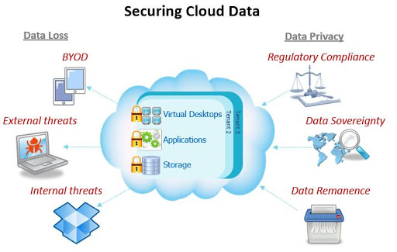

Slide 18
References
Text books:
Buyya, Rajkumar, James Broberg, and Andrzej M. Goscinski, eds. Cloud computing: Principles and paradigms. Vol. 87. John Wiley & Sons, 2010.
Miller, Michael. Cloud computing: Web-based applications that change the way you work and collaborate online. Que publishing, 2008
Websites:
https://intellipaat.com/blog/tutorial/amazon-web-services-aws-tutorial/advantages-and-disadvantages-of-cloud-computing/
https://www.guru99.com/advantages-disadvantages-cloud-computing.html
https://www.geeksforgeeks.org/issues-in-cloud-computing/
https://www.calyptix.com/research-2/top-5-risks-of-cloud-computing/

Slide 19
THANK YOU

